Slide 1
Replicating Depth from Focus with a Manual Camera
Yann & Mack

Slide 2
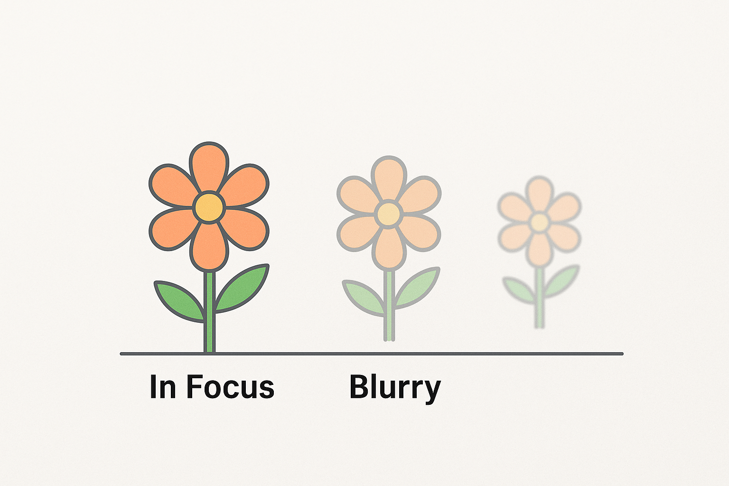










What is Depth from Focus?
Produces a depth map by analyzing focus across images of the same scene.
Focal Stack
All-in-focus Image

Slide 3
We have the focal stack, what now?
Focal Stack
We want to find a preserve the « in focus » pixels.

Slide 4
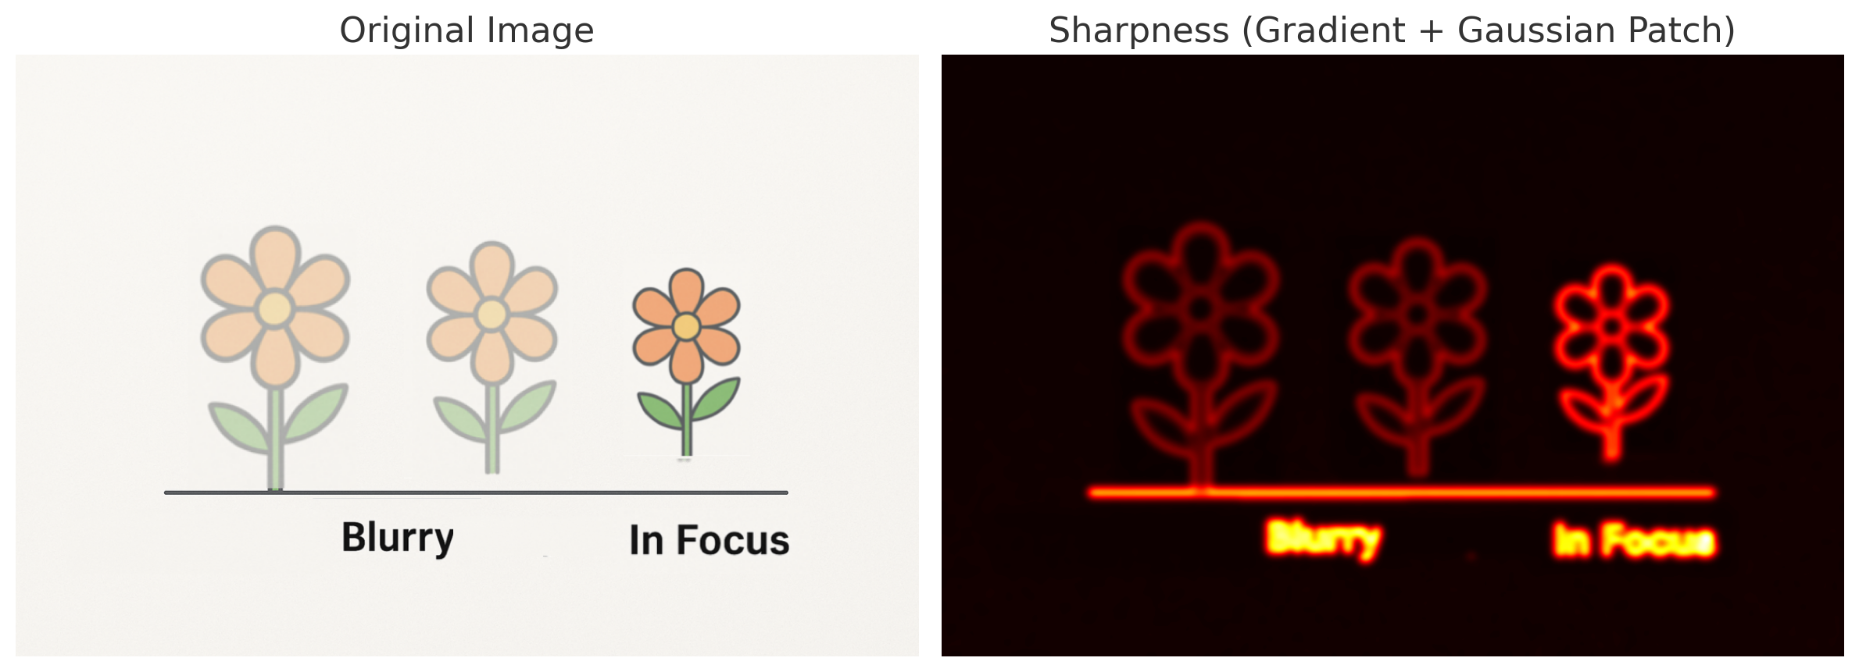

Sharpness as a Measure of Focus
Calculate gradient magnitude over a Gaussian patch to quantify pixel sharpness. This can be used as a score.

Slide 5
On the Quest for Full Image Sharpness
Each pixel chooses its sharpest frame (highest sharpness score).
We frame this as a labeling problem across the focal stack.
Frame 10
Frame 20
Label selection « 10 »
Label selection « 20 »

Slide 6
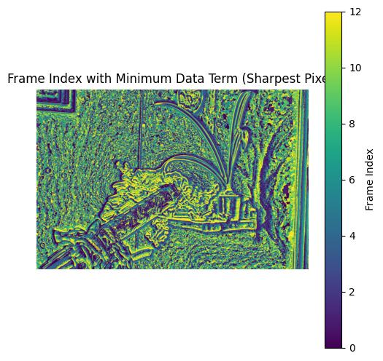
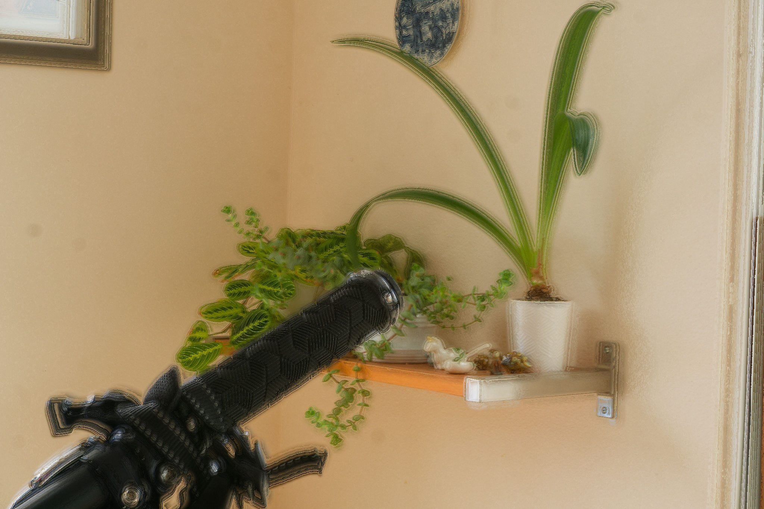
Why Not Just Pick the Sharpest Pixel 🥹?
Leads to noisy results!
Tiny changes in sharpness scores can cause flickering labels
Neighboring pixels may select different focus levels leading to spatial inconsistency.
We need a global solution that balances sharpness and spatial smoothness

Slide 7
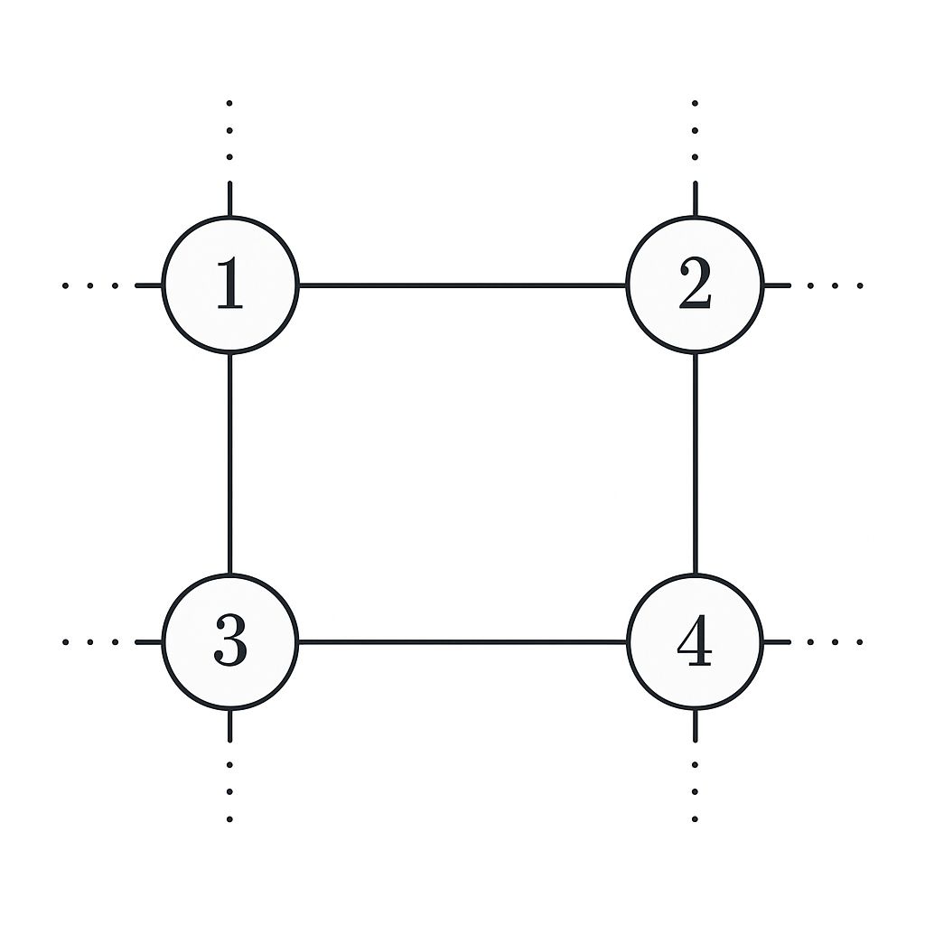
Defining the problem Space
We define the pixel space as a Markov Random Field on a regular 4-connected grid where the labels are the indices to each frame in the focal stack.
Node 2 = pixel 2

Slide 8

Energy Minimization Objective
We minimize an energy function!!
Smoothness term: penalizes neighboring pixels for picking different frames. Encourages spatial coherence. λ balances this with the data term
Data term: how sharp pixel i is in its chosen frame. Lower if the pixel is in focus.

Slide 9


Energy Minimization Objective
Node i
Node j
Smoothness term: penalizes neighboring pixels for picking different frames. Encourages spatial coherence. λ balances this with the data term
Data term: how sharp pixel i is in its chosen frame. Lower if the pixel is in focus.
gradient over pixel
Diff of label

Slide 10

Do I Hear Optimization Problems?
Solving the Labeling with an alpha-expansion:
Iteratively pick a label (frame index) alpha
For every pixel, consider switching its current label to alpha
Solve this binary decision efficiently via graph cut
(Repeat)

Slide 11
Graph Cut in Practice
Legend
Sharpest pixel frame Ground Truth
sink
𝜶
𝜶 + 10
Best Chosen Label
𝜶 - 3
𝜶
𝜶 - 5
𝜶
𝜶 - 1
𝜶 + 1
𝜶
𝜶 -1
𝜶
Label 𝜶
Notes:
Pixels 1 and 3 are sharp in label α → they connect to the source.
• Pixel 4 is currently at α+1 but neighbor 3 switches to α.
• If pixel 4 is not much blurrier in α, it will switch too (due to smoothness).
• Pixel 2 has a distant label (α+5); if its sharpness is poor, it may also switch to α.
• Graph cut balances sharpness (data) and neighbor agreement (smoothness).

Slide 12
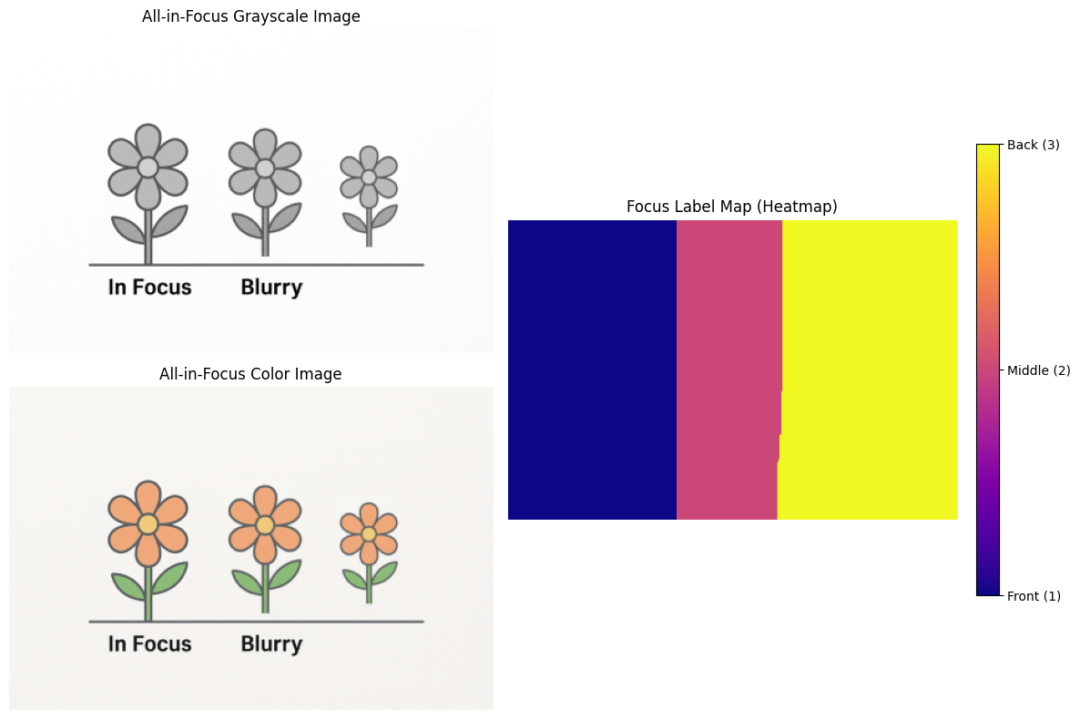
Yay! You have an All-in-Focus Image

Slide 13
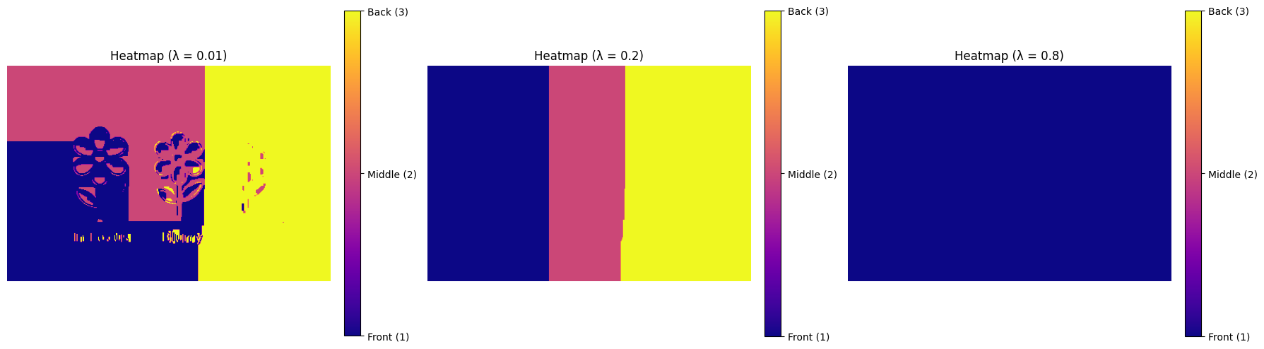
Yay! You have an All-in-Focus Image

Slide 14
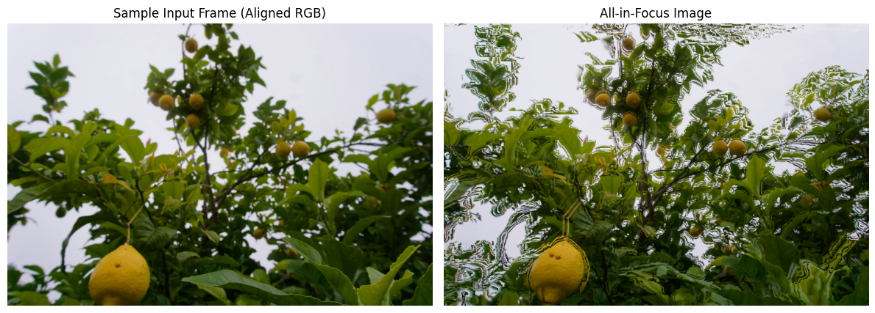
Yay! You have an All-in-Focus Image??

Slide 15
The Nitty Gritty: Alignment of the Focal Stack
Align focal stack to compensate for parallax and viewpoint shifts
Challenges:
Defocus and magnification vary across the stack
Optical flow between far-apart frames fails due to appearance differences

Slide 16
Alignment of the Focal Stack
Warping an Image with Optical flow
Equation shifts each pixel according to the estimated motion between images, aligning it with a reference frame.
Warping function using flow F
Original pixel at position (u,v)
Fx and Fy vertical flow offsets

Slide 17

Alignment of the Focal Stack
We compose flows incrementally, aligning each image to the reference, one step at a time
Flow for image i to ref image 1
Flow for image i to ref image i-1
Flow for image i-1 to ref image 1

Slide 18
Yay! You have an All-in-Focus Image
IMAGE OF ALL IN FOCUS OUTPUT

Slide 19
From Labels to Depth
Each pixel’s label (frame index) gives a coarser depth estimate
Use the camera’s focus-distance vs blur-radius model
Optimize camera parameters + depth jointly
Output: a refined depth map from the label map

Slide 20
Depth and Camera Parameter Estimation
This changes for our case!
Use Sony’s A6000’s recorded focus settings for calibration
Apply thin lens equation to relate:
Focus distance
Aperture (f-number)
Focal length (fixed or known)
Estimate:
Depth per pixel
Per-frame focus distance offsets
Solve via nonlinear least squares using label map as initialization

Slide 21
Handling Bokeh
Bokeh = strong defocus blur from wide aperture
Can cause false sharpness peaks near edges or highlights
We handle this by
Using gradient-based sharpness over patches
Enforcing spatial smoothness via MRF to reduce artifacts
Ensures true focus is captured — not just visually striking blur.

Slide 22
Original Image Examples
INSERT IMAGES

Slide 23
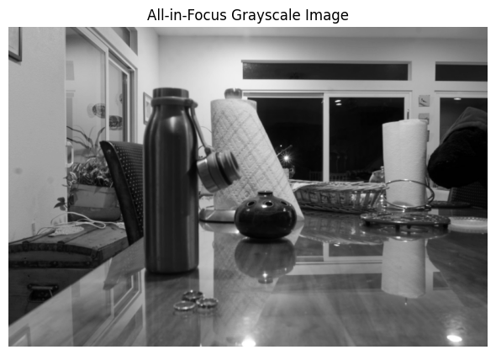
All-in-Focus Output
KEEP CURRENT IMAGES, ADD ALL-IN-FOCUS

Slide 24
Depth Map Outputs
KEEP CURRENT IMAGES, ADD DEPTH MAPS

Slide 25
Challenges: Welcome to Coding Hell
If this slide is used I will cry

Slide 26
References & Achnowledgments
Thank you Chatgpt for all visualization
github.com/Yann-b-b/All_in_focus

